Slide 1

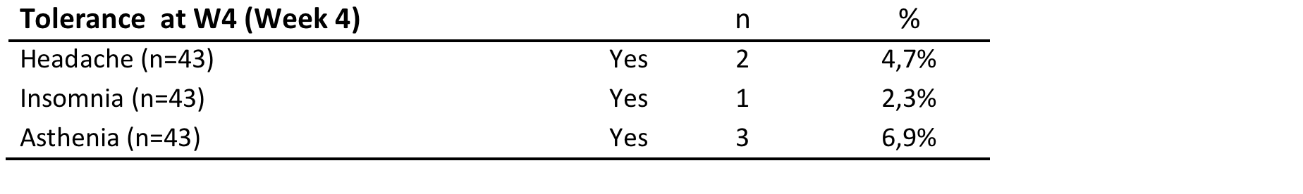
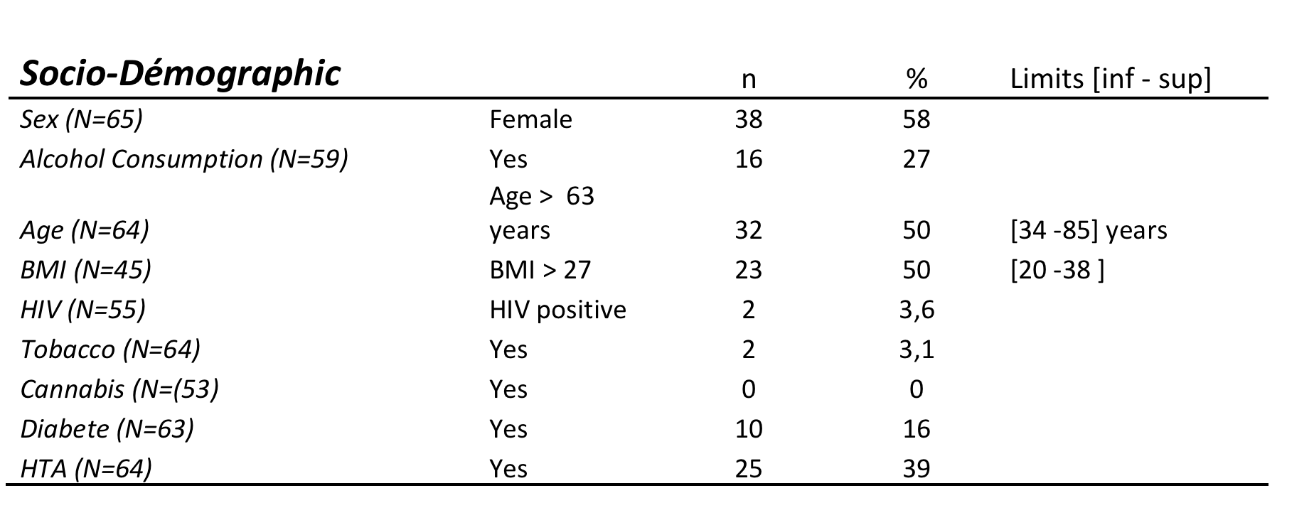

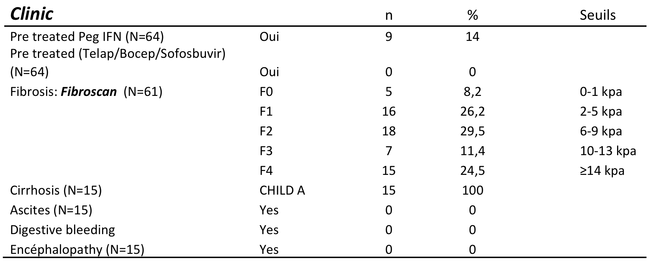
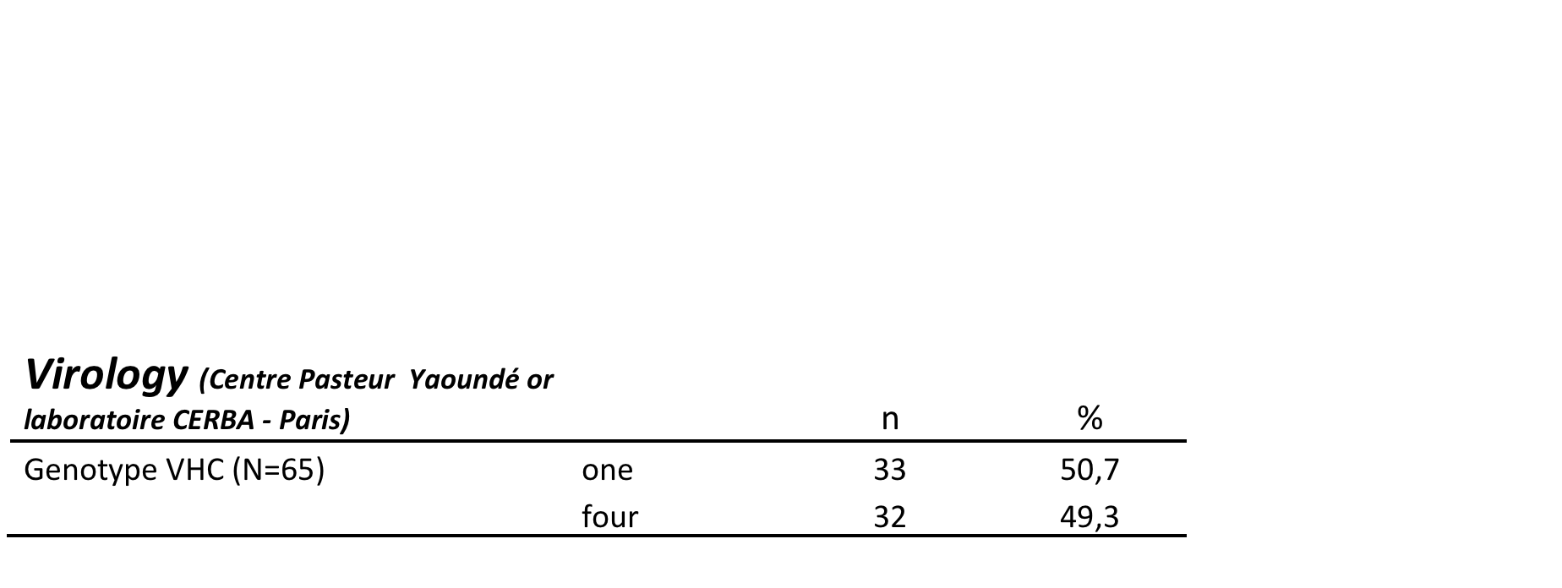
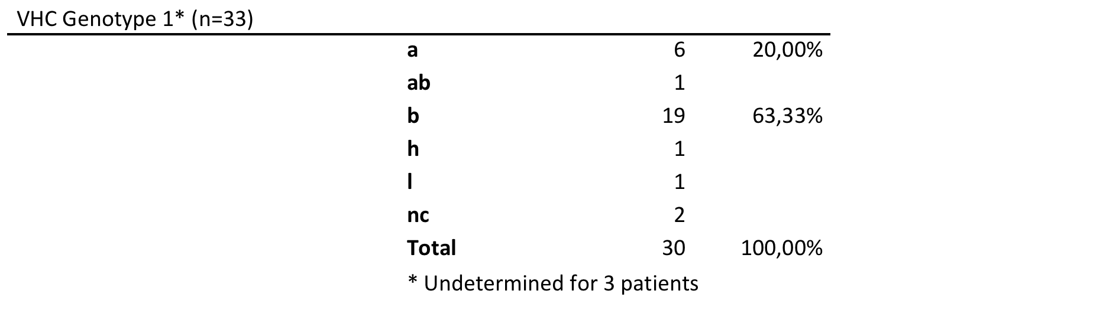
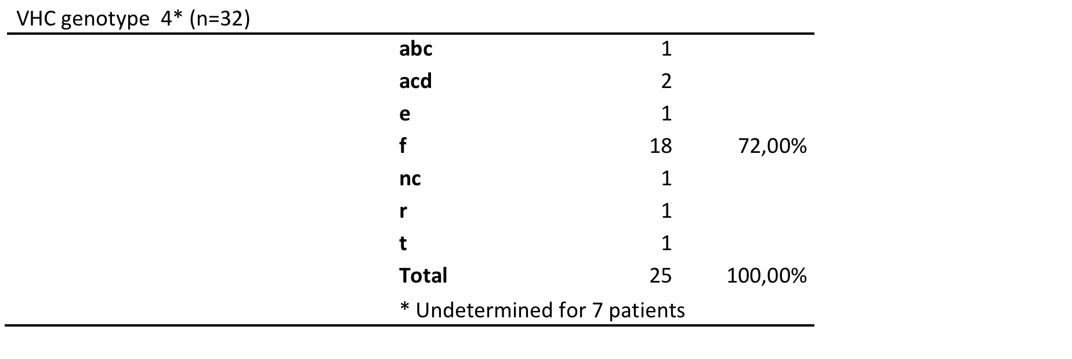
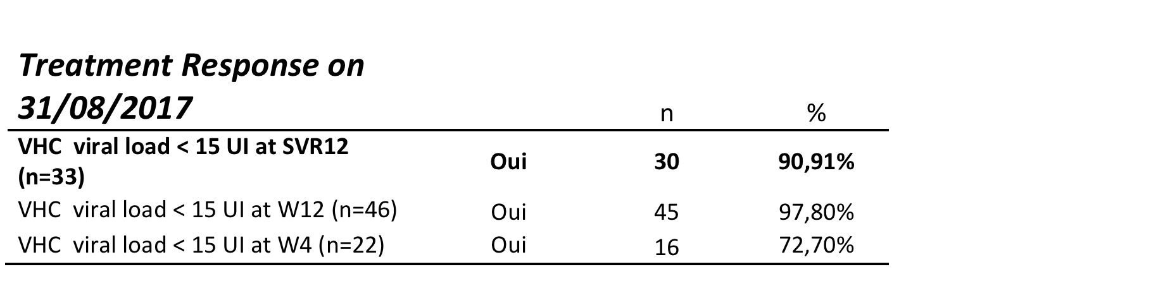
Sofosbuvir/Ledipasvir : Efficacy and tolerance in HCV positive naïve or pre-treated patients in Cameroun
POLYCLINIC BORDEAUX DOUALA
CAMEROUN
S. TCHAMGOUE¹, H. LEUNDJI², M. TAGNY-SARTRE³, C. TZEUTON⁴, M. BIWOLé SIDA⁵, G. MARZOUK⁶, G. ESMAT⁷
1Polyclinic Bordeaux-Douala, Douala, Cameroun 4Centre Médical les capucines, Douala, Cameroun
2SOS hepatitis, Douala, Cameroun 5Cameroun minitry of health, Yaoundé, Cameroun
3Centre Médical La cathedrale, Yaounde, Cameroun 6Marcyl Pharmaceutical Company, Cairo, Egypt 7Faculty of medecine, Cairo, Egypt
Introduction
Central Africa is considered to be an area of high endemic hepatitis C infection.
In Cameroun, HCV sero prevalence in general population is around 2 to 7%. Otherwise, HCV is characterized in Cameroun by its high genetic diversity with the circulation of three different genotypes HCV-1, HCV-2 and HCV-4 and more than 10 HCV subtypes.
Cameroun health authorities have decided to import and prescribe Direct Acting Antivirals (DAA) in generic form from 29/07/2016. Decentralization of ADC prescriptions in five of the ten regions followed, under the operational responsibility of the Regional Therapeutic Committees. This was the genesis of this observational study, approved by Cameroon’s National Committee of Ethics, whose purpose was to check the efficiency of these new generic antiviral treatment on local VHC viral strains characterized by their phylogenetic diversity, under normal conditions of use in the regions You may edit the size of the font, the sections distribution and the colour scheme if wanted. All modifications concerning the background/title display are to be done at a Master Slide level.
Results
Conclusions
In this local regional Camerounian context, the efficiency (90% percent of patients cured) and tolerance of this Sofosbuvir/Lédipasvir generic form was similar to the data previously published in developed country
Acknowledgements
AIM
To assess the safety and efficacy of fixed-dose combination SOF/LED (Sofosbuvir 400 mg/Ledipasvir 90 mg) in the treatment of chronic HCV- 1 & 4 infected patients
Method
Observational prospective non comparative pilot study
Inclusion criteria : Age ≥ 18, Chronic HCV infection genotype 1 or 4, HCV naïve or pre-treated patients, Signature of consent to treatment
Exclusion criteria: Pregnant or nursing female or male with pregnant female partner, HBV co-infection, Liver decompensation, Hepatocellular carcinoma or other malignancy, Other medical disorder that may interfere with subject treatment, Creatinine Clairance MDRD < 70 ml/mn,, Ongoing drugs : Antiarythmic drugs : Amiodarone, Digoxin, Amlodipine, Diltiazem, Lipid lowering drug : Rosuvastatin, P-glycoprotein interactive drug : Rifampicine, Carbamazepim, Ongoing Local Traditional Drugs.
Intervention
Drug 1: SOF/LDV, Mpiviropack Plus*(Marcyl pharmaceutical-Le Caire, Egypt): one tablet per day during 12 weeks
Drug 2 RBV : Ribavirine 200 mg. dosing recommendations (< 75 kg = 1000 mg and ≥ 75 kg = 1200 mg). If previously treated with Peg interferon)
Endpoint
Percentage of patients with Sustained Virologic Response (SVR) defined as HCV viral load < 15UI/ml twelve weeks after the end of treatment,
Three patients experienced a virologic failure at SVR12 : the first one was genotype 1 e pre treated with peg-IFN ; the second exposed to proto pomp inhibitor, and the last patient got cirrhosis and was previously treated with Sofosbuvir/Ledispasvir during twelve weeks without ribavirine.
References
- Virology. 2014 Sep;464-465:233-43. doi: 10.1016/j.virol.2014.07.006. Epub 2014 Aug 6.
Phylogeography and epidemic history of hepatitis C virus genotype 4 in Africa.
Iles JC1, Raghwani J1, Harrison GL2, Pepin J3, Djoko CF4, Tamoufe U5, LeBreton M5, Schneider BS5, Fair JN5, Tshala FM6, Kayembe PK7, Muyembe JJ8, Edidi-Basepeo S9, Wolfe ND10, Simmonds P11, Klenerman P12, Pybus OG13
Lancet Infect Dis. 2015 Jul;15(7):819-24. doi: 10.1016/S1473-3099(15)00006-7. Epub 2015 May 5.
Hepatitis C seroprevalence and HIV co-infection in sub-Saharan Africa: a systematic review and meta-analysis.
Rao VB1, Johari N2, du Cros P3, Messina J4, Ford N5, Cooke GS6.
CONTACT INFORMATION
Dr Serge Tchamgoué
E-mail : stchamgoue@yahoo.fr
Tel : (237) 6 94 08 70 57
facebook

